Slide 1

Center for Development of Advanced Computing - Patna
Vidyadayinee Online Study Web Portal
By
CHOUDHARY DINESH JEEVAN (PRN No.: 220980720031) PANKAJ MUDE (PRN No.:220980720071)
KAPIL PATIL (PRN No.:220980720072)
ADARSH RAVINDRAN (PRN No.:220980720005)
SHRIDHAR JAKKAN (PRN No.:220980720104)
Guided By
ABUSHAHMA ANSARI

Slide 2
Agenda
Introduction
Methodology / Techniques
Implementation
Results & Conclusion
References

Slide 3
Introduction
Before the advent of online study tools, learners and educators faced several challenges such as geographical barriers, time constraints, limited interactivity and high cost of offline study.
Online Study Web Portal, is designed to provide a seamless and engaging online learning experience for students and instructors. With the increasing demand for online education, the need for a comprehensive and user-friendly platform has become more important than ever.

Slide 4
Methodology / Techniques
The Online Study Web Portal is a web-based application that is built using a three-tier architecture. The architecture consists of three layers:
Presentation layer: This layer is responsible for presenting the user interface to the users. It includes the web pages, forms, and other UI components that enable users to interact with the platform.

Slide 5
Methodology / Techniques
2. Application layer: This layer contains the business logic of the platform. It processes the user inputs and interacts with the database to retrieve and store data.
3. Database layer: This layer is responsible for storing the data of the platform. It includes the database server and the database management system (DBMS).

Slide 6
Methodology / Techniques
The platform is built using the following technologies:
Front-end technologies: HTML, CSS, Bootstrap and ReactJS.
Back-end technologies: SpringBoot and MySQL database.
(Dependencies Used In SpringBoot : Spring Web, Spring Data JPA, MySQL Driver, Spring Boot DevTools.)

Slide 7
Implementation
The Online Study Web Portal project aims to create an online learning platform that offers an immersive learning experience for students and instructors. The platform comprises three main modules: Admin, Instructor, and Student.
The Admin module manages the student and instructor accounts, courses, and content on the platform. The Instructor module allows instructors to create and manage courses on the platform, while the Student module enables students to browse and enroll in courses.

Slide 8

Implementation

Slide 9
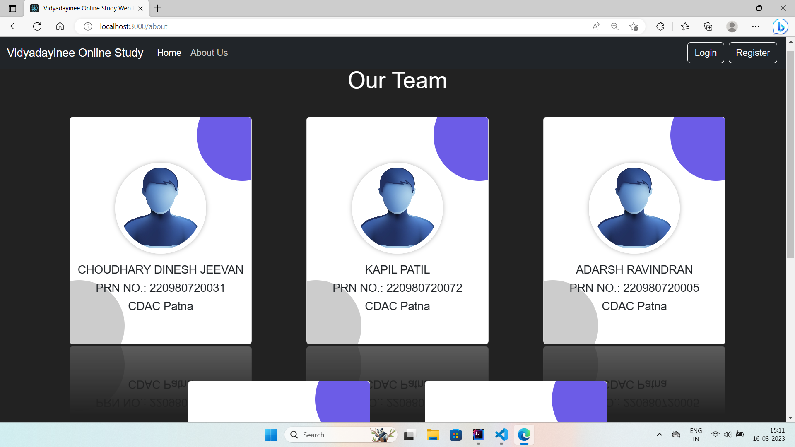
Implementation

Slide 10
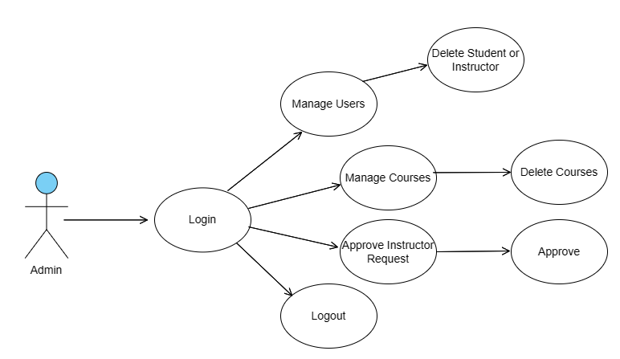
Implementation
Use Case Diagram : Admin

Slide 11
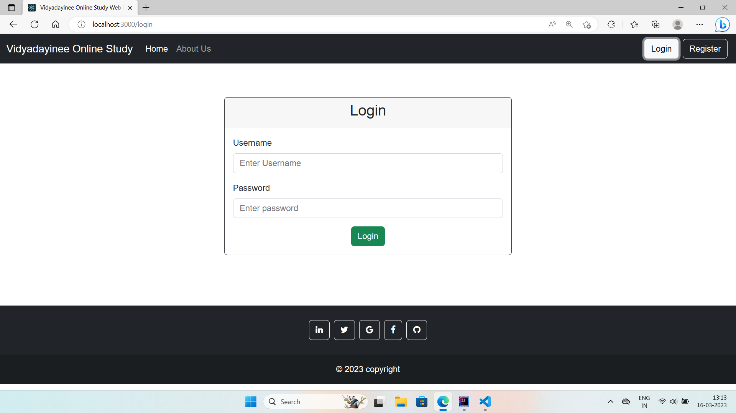
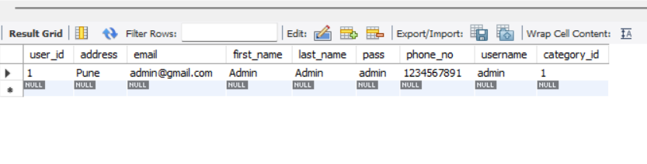
Implementation

Slide 12
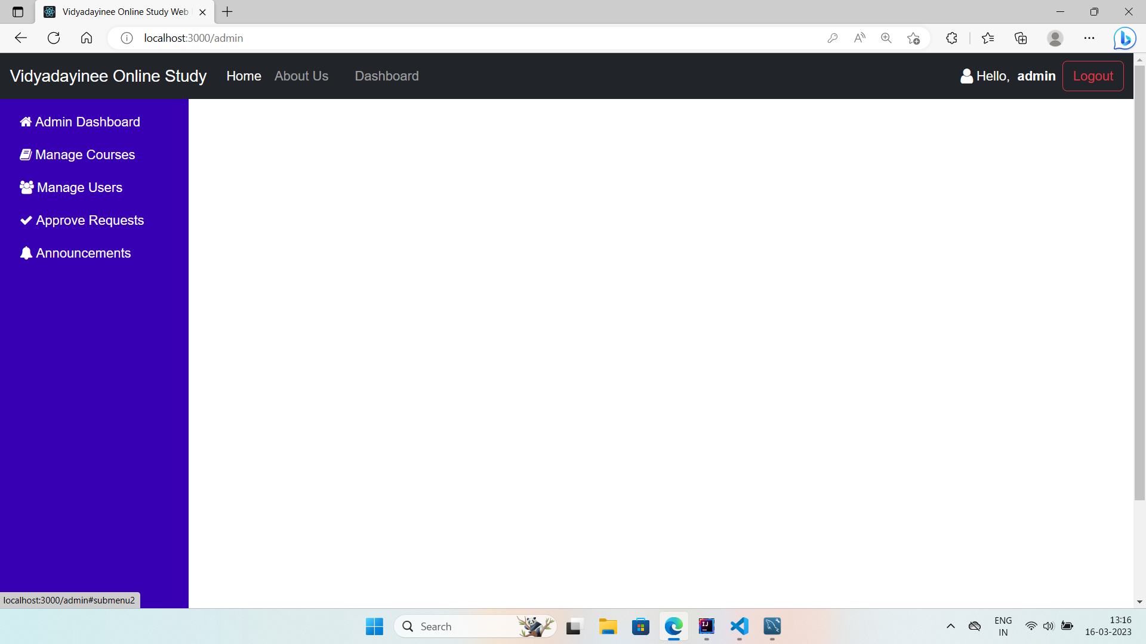
Implementation

Slide 13
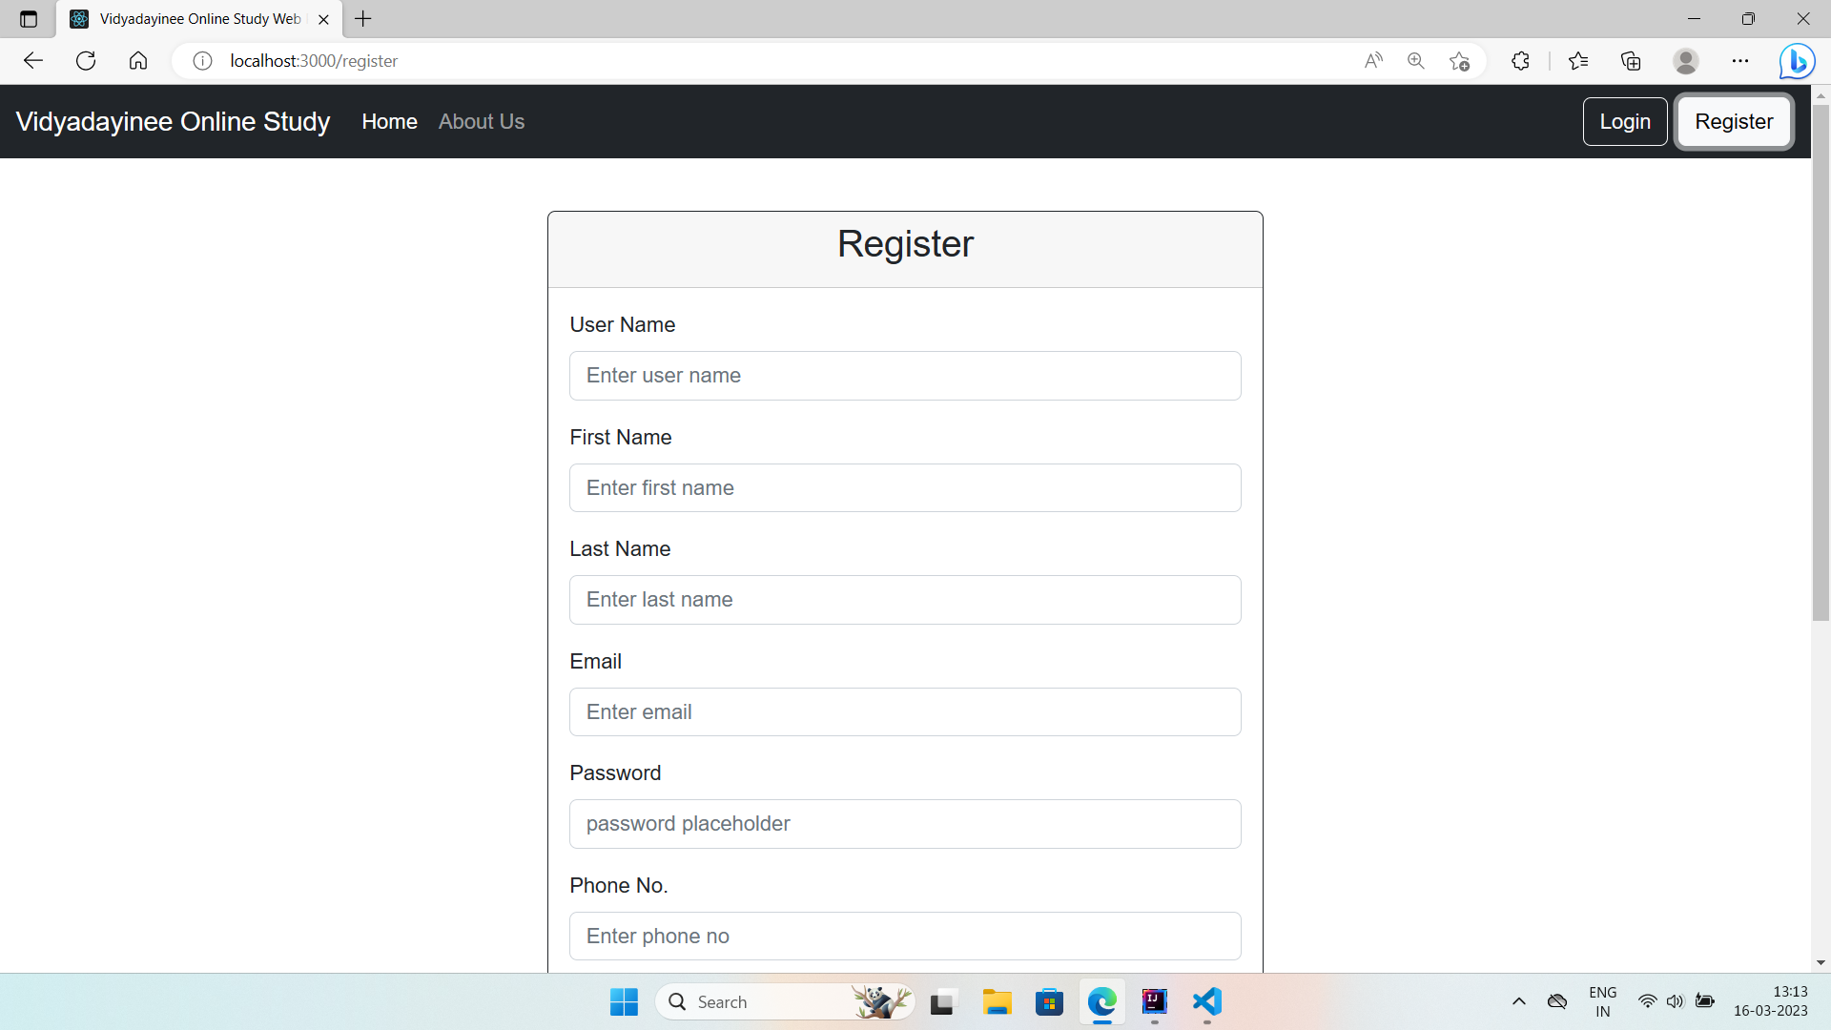
Implementation

Slide 14
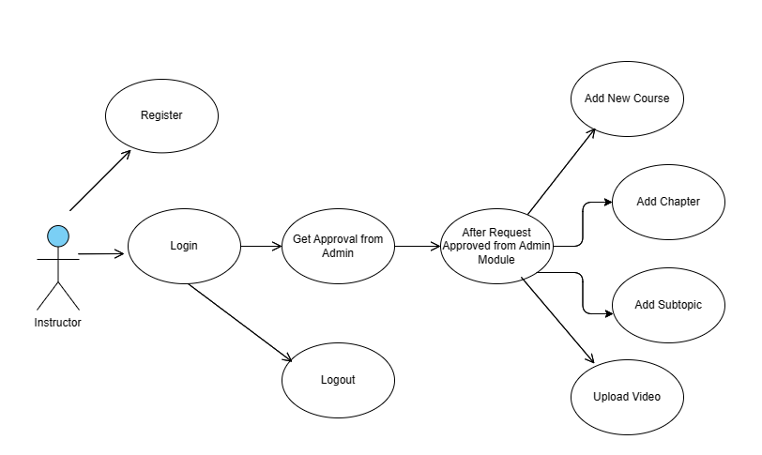
Implementation
Use Case Diagram : Instructor

Slide 15
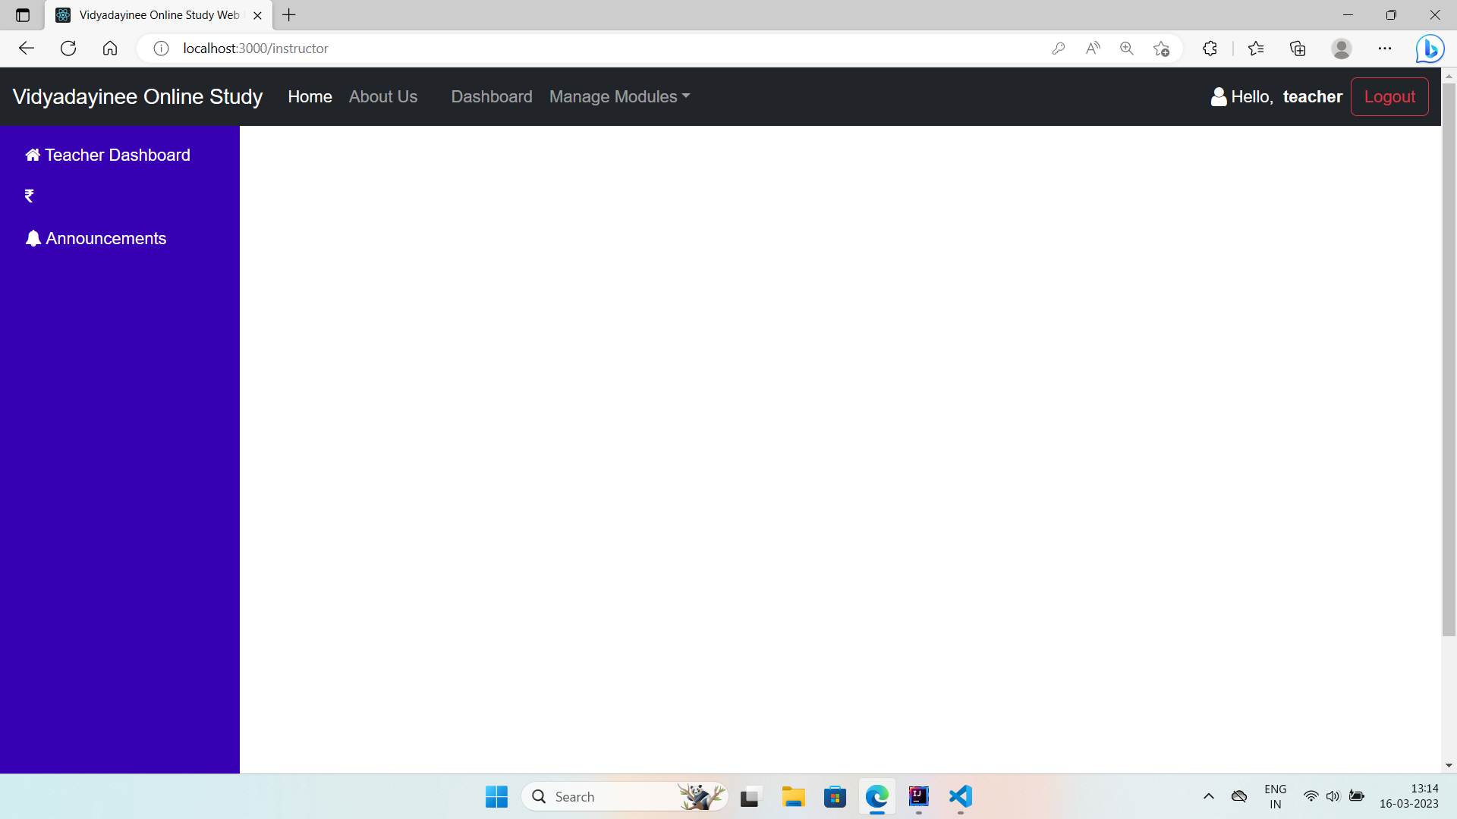
Implementation

Slide 16
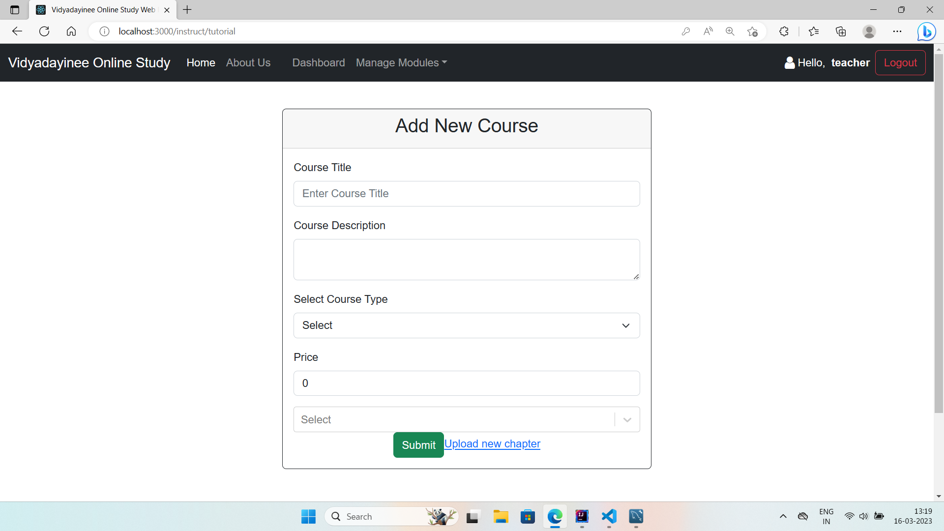
Implementation

Slide 17
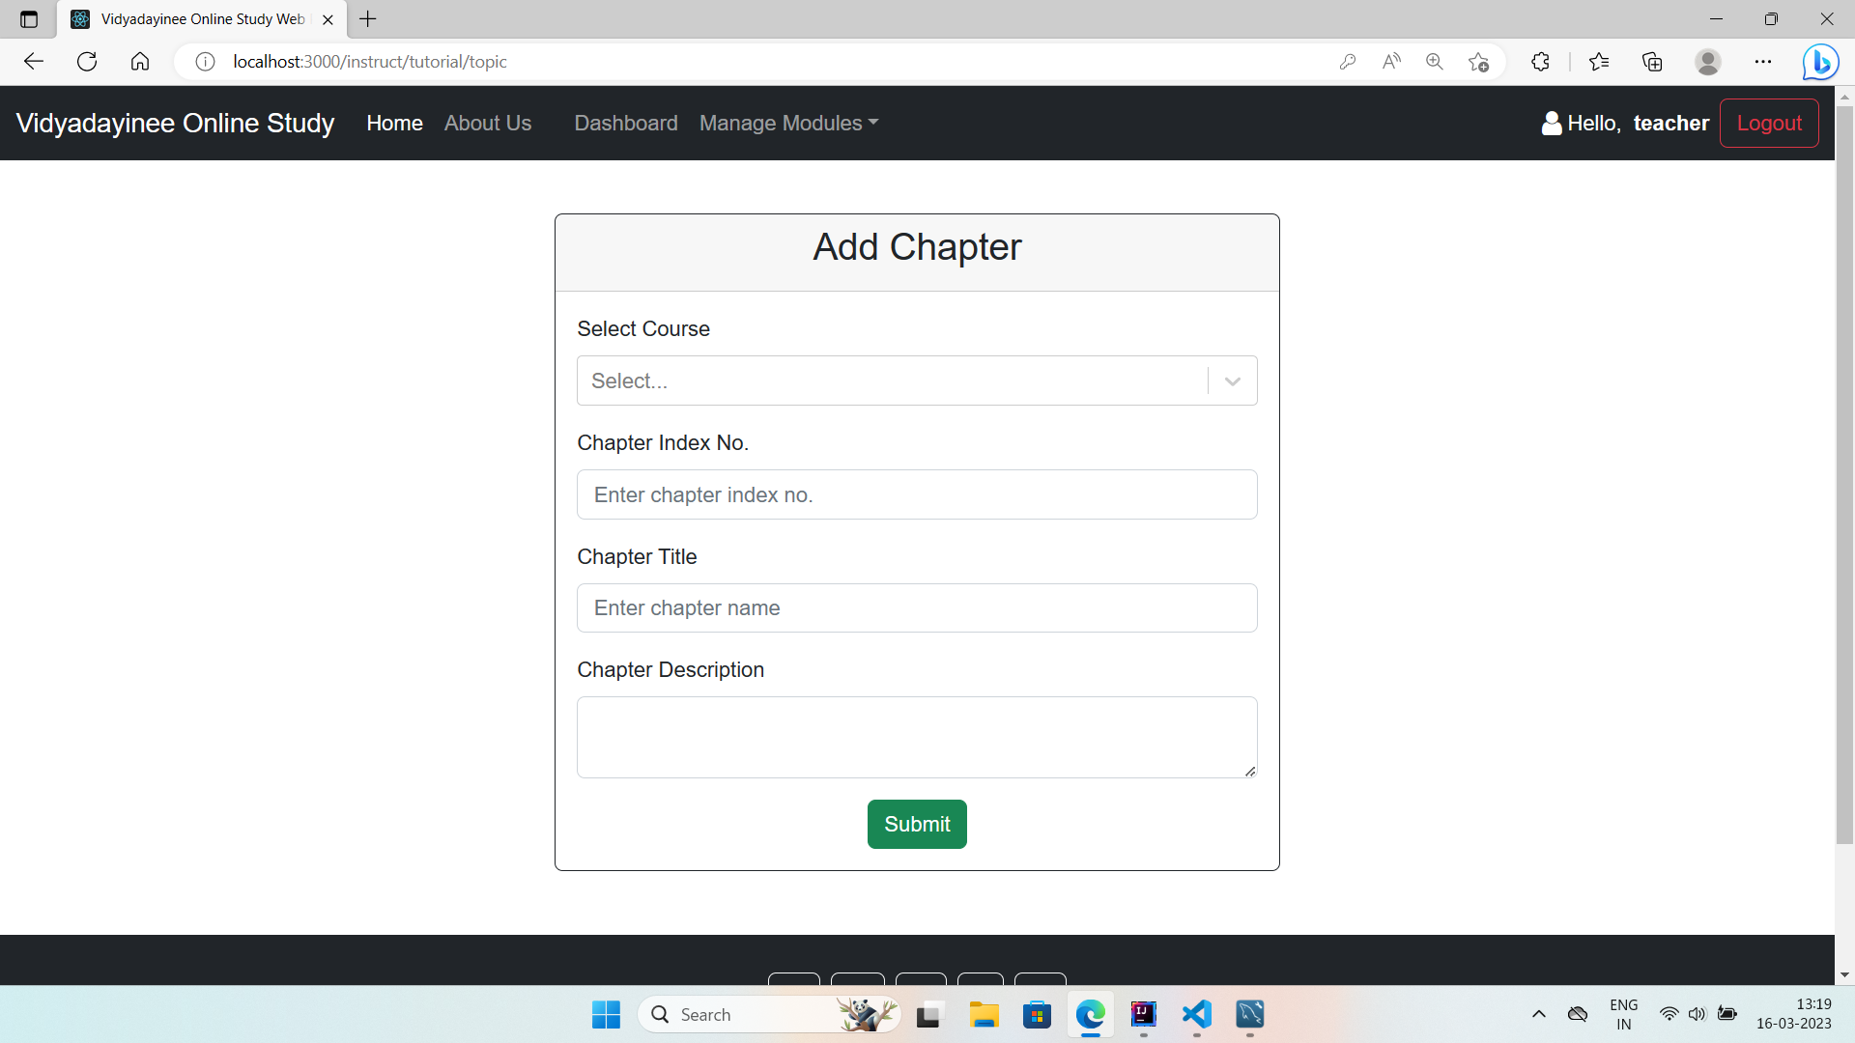
Implementation

Slide 18
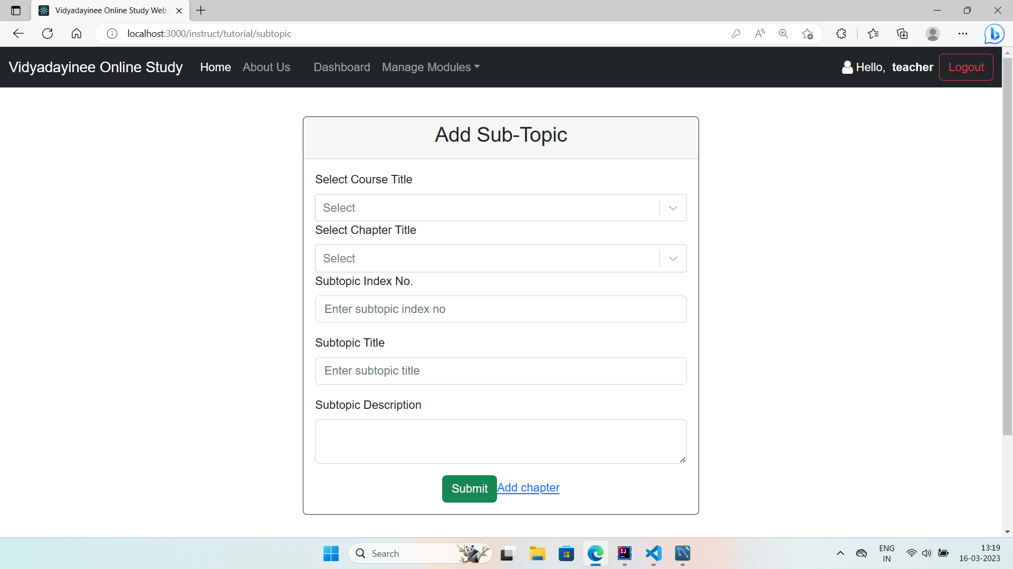
Implementation

Slide 19
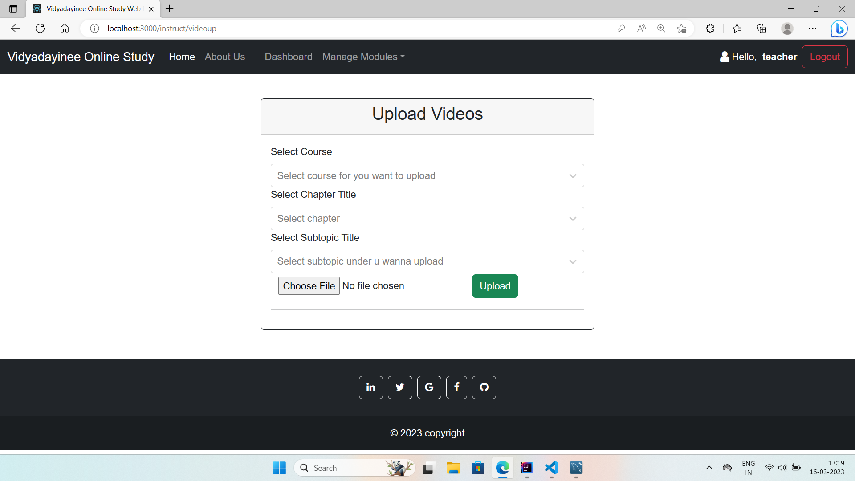
Implementation

Slide 20
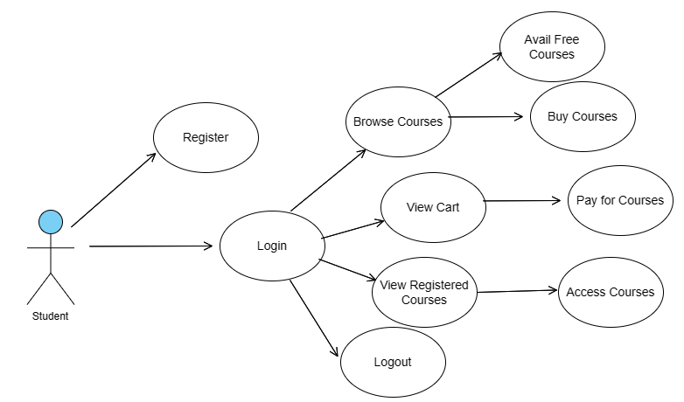
Implementation
Use Case Diagram : Student

Slide 21
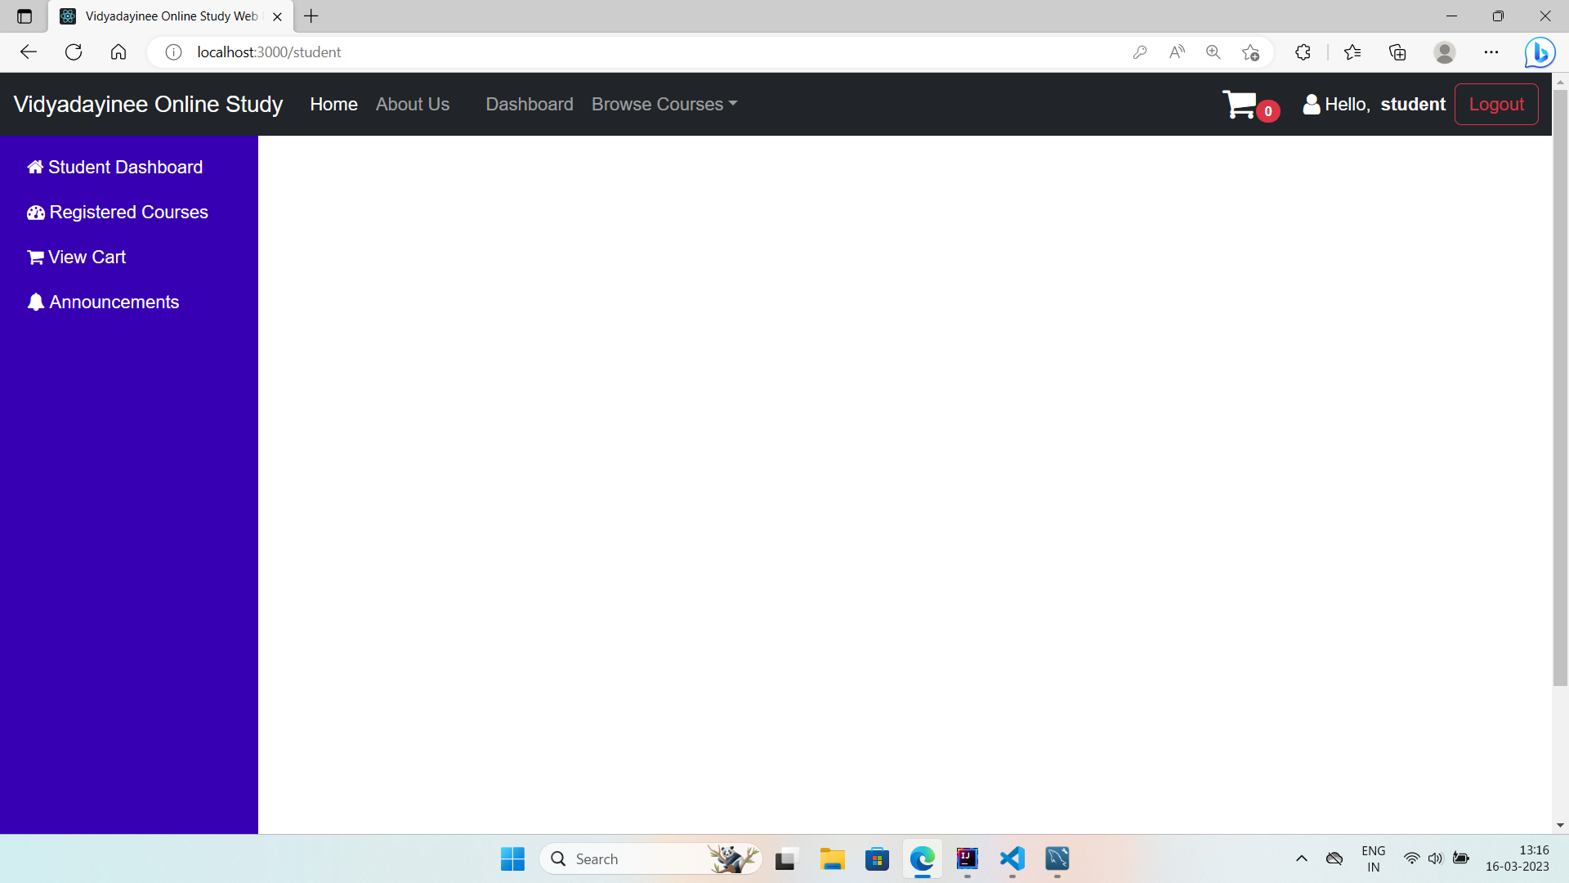
Implementation

Slide 22
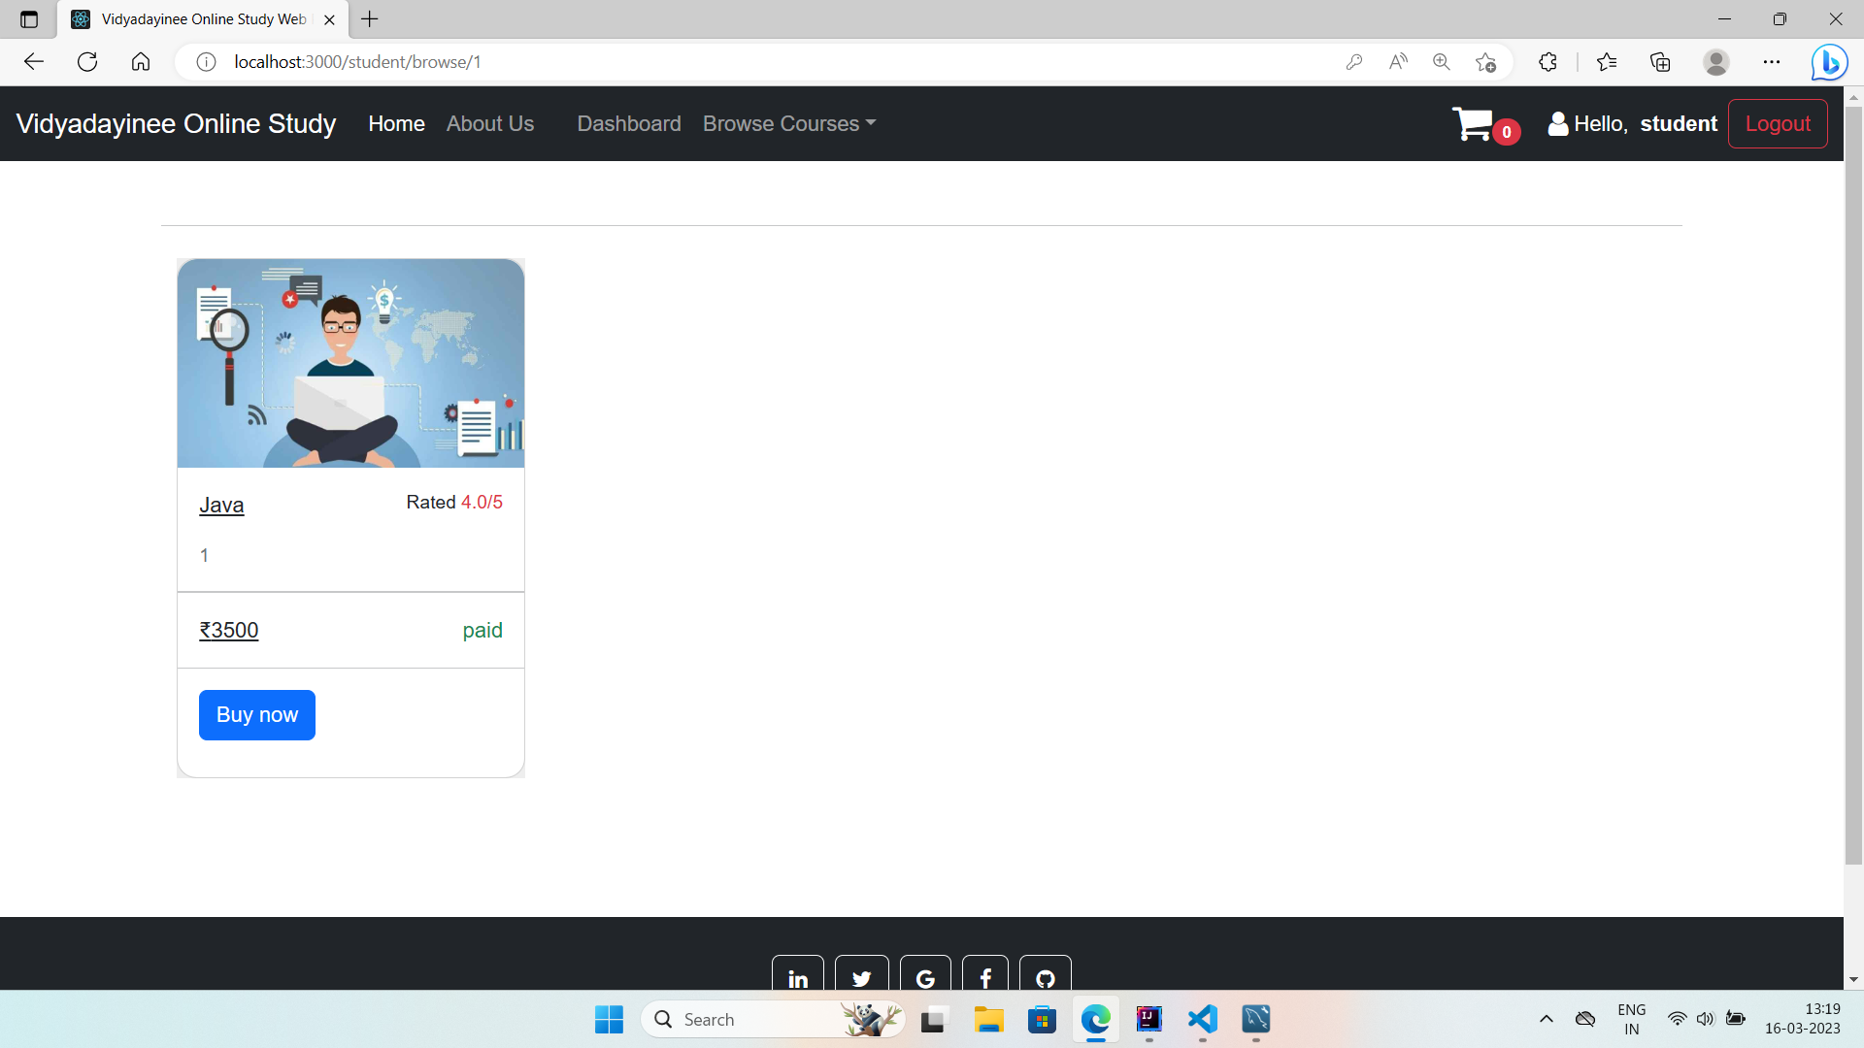
Implementation

Slide 23
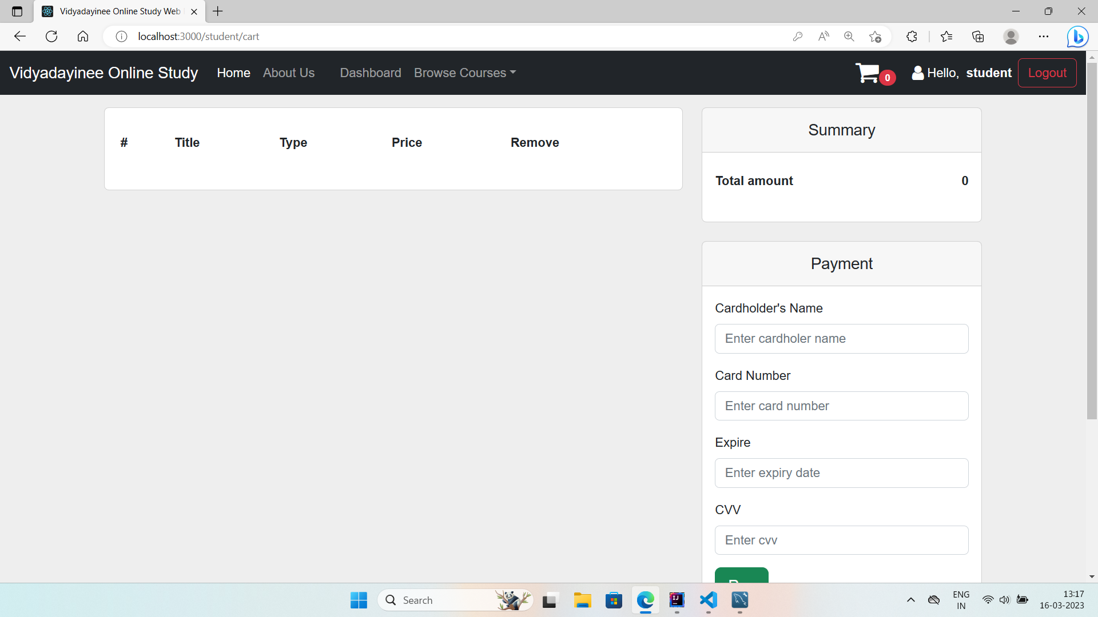
Implementation

Slide 24
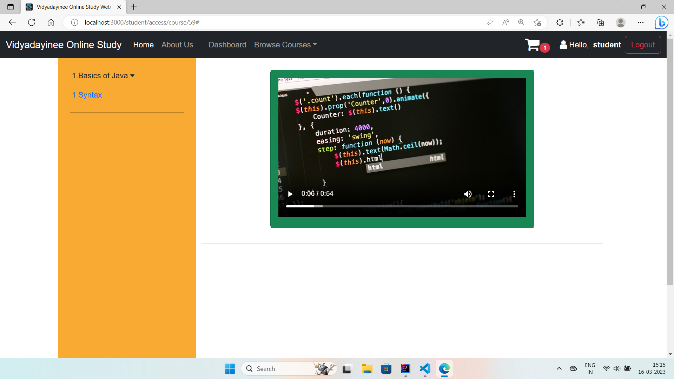
Implementation

Slide 25
Results & Conclusion
The Online Study Web Portal is a comprehensive and user-friendly platform that caters to the needs of modern-day learners and instructors. With its easy user interface and personalized learning paths, the platform offers a seamless and engaging online learning experience for students.
By using a three-tier architecture and the latest technologies, we were able to develop a platform that is easy to use, engaging, and effective. The platform's modular design allows for easy integration of new functionalities, ensuring that it can adapt to the changing needs of learners and instructors.

